Slide 1
MAS: Project Ubin

Slide 2
Current problems with financial infrastructure
Cost of maintenance (Due to complex legacy systems)
Risks (increasing risk of downtime and system failures)
Friction (commissions, fees, etc.)
Notes:
Cost since legacy systems are continuously added

Slide 3
Why use Distributed Ledger Technology (DLT)?
Everyone has a copy of the ledger (i.e. each node is a client and a server)
Digital identity using Public key cryptography (Use of private/public key to establish identification between users)
Consensus mechanism (Agreement between users of the system, ensuring data on the ledger is validated according to the rules of the system and to prevent double spend attack)

Slide 4
Why use Distributed Ledger Technology (DLT)?
System is distributed, hence high availability. A secure source of proof that the transaction has occurred and was processed
All records on the distributed ledger can be verified, mitigating the risk from attacks such as double-spending, fraud, abuse, manipulation of transactions.
System participants can continuously validate blocks without interference and prevent modifications to previous transactions’ conducted

Slide 5
Benefits
P2P model, eliminates intermediate party even in absence of trust
Secured by cryptography, increases security and protection of data and identity
Automation of complex, agreements and business processes through smart contracts
Immutability prevents changes to the data, makes it resistant to fraud and hacking
Allows for near real-time settlements, removes intermediate party
Allows two or more trustless parties to transact directly with each other through cryptographic proof and without third-party interference

Slide 6
Aims for DLT implementation
Reduction of manual efforts required to perform transactions
Improves real-time monitoring of financial activity between regulators and entities
Agreements are codified and executed in a shared, transparent and immutable environment, reducing the reliance of counterparty
Near real-time settlement through removal of third-parties required for verification and validation of transactions
Reduces the requirement for capital to be reserved and allows for greater transparency on liquidity and asset
Reduces fraud as everyone has full transaction history
Notes:
Counterparty – opposite party in a contract or financial transaction

Slide 7
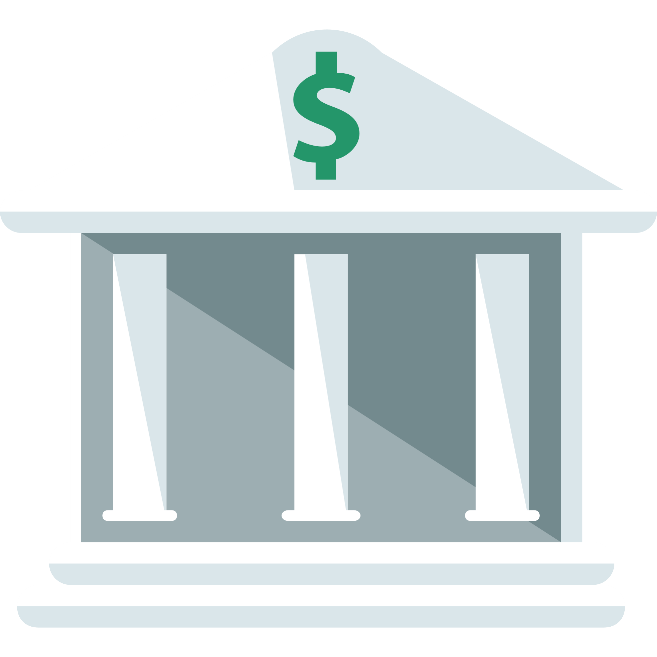
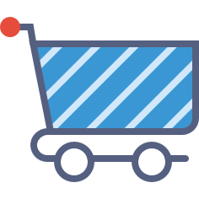

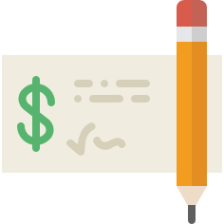
Risks of current cross-border transactions: Settlement/Replacement Risk
Entity A
Entity B
Border
Notes:
Assume that a contract states that the entity needs to deliver products but is now unable to do so now. Settlement risk: defaults. Replacement risks: replacement in the form of assets, interests, collateral can be used but due to delays, value may fluctuate depending on market forces

Slide 8
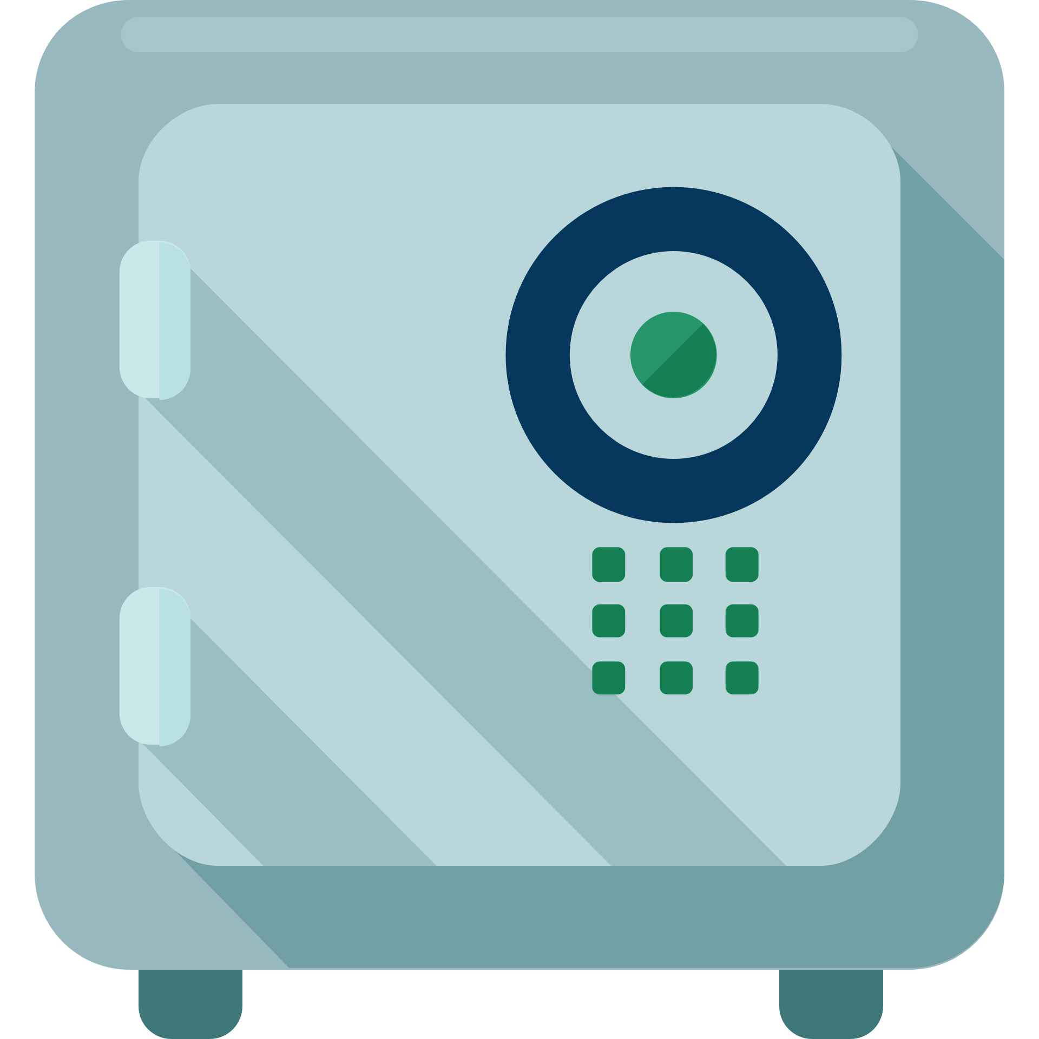
Risks of current cross-border transactions: Inefficient funding
Accounts for cross-border transactions
Excessive funding for worst case scenario Example: Cross-border fees etc
Entity A
Entity B
Border
Notes:
Assume that a contract states that the entity needs to deliver products but is now unable to do so now. Settlement risk: defaults. Replacement risks: replacement in the form of assets, interests, collateral can be used but due to delays, value may fluctuate depending on market forces

Slide 9

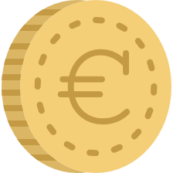
Risks of current cross-border transactions: Reconciliation costs
Entity A
Entity B
Border
Notes:
Reconciliation costs, due to real-time stock position affecting value of products

Slide 10
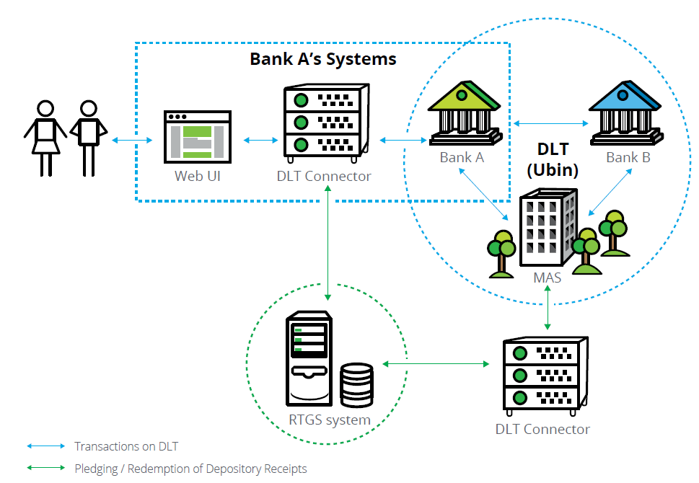
Architecture

Slide 11
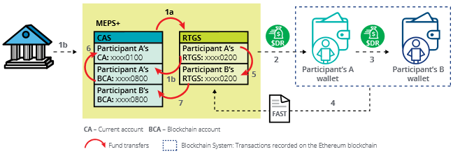
Workflow Diagram
1a
Excess monies in the current account (CA) above the minimum required will be transferred to the RTGS account (interbank transfers within working hours)

Slide 12
Workflow Diagram
1b
Participant A requests top-up of Blockchain Account (BCA), funds from RTGS will be transferred to BCA

Slide 13
Workflow Diagram
1b
MAS verifies the collateral that was transferred into the BCA

Slide 14
Workflow Diagram
2
After verification, MAS issues the Depository Receipt (DR) to recipient A using the smart contract

Slide 15
Workflow Diagram
3
Transactions were made in the form of DR from participant A to B. These transactions use the Ethereum network

Slide 16
Workflow Diagram
4
The transaction in the blockchain will send a FAST settlement file to the RTGS

Slide 17
Workflow Diagram
5
The monies in the RTGS account of participant A will be debited and credited into the RTGS account of participant B

Slide 18
Workflow Diagram
While step 5 occurs, the reduction of the DR will cause the debiting of the CA for participant A (BCA balance ↓ = RTGS balance ↓ when DR is redeemed to SGD = CA balance ↓)
6

Slide 19
Workflow Diagram
7
The BCA balance of participant B will increase as a result of the crediting of DR

Slide 20
Further Exploration
Block synchronization across all nodes at the same time
Development of contract establishment and testing standards
Securing of data using encryption to ensure privacy
Notes:
Counterparty – opposite party in a contract or financial transaction

Slide 21
References
http://www.investopedia.com/terms/r/replacementrisk.asp
https://www.techuk.org/component/techuksecurity/security/download/240?file=Financial_infrastructure_-_can_banks_afford_no_to_change_WEBSITE.pdf&Itemid=181&return=aHR0cHM6Ly93d3cudGVjaHVrLm9yZy9pbnNpZ2h0cy9yZXBvcnRzL2l0ZW0vMjQwLWZpbmFuY2lhbC1pbmZyYXN0cnVjdHVyZS1jYW4tYmFua3MtYWZmb3JkLW5vdC10by1jaGFuZ2U=

